Slide 1
PBHLT 7115 Causal Methods in Public Health
Week 1
Session 1b: Counterfactuals and DAGS
Jan 11th, 2024

Slide 2

Agenda
Review & review of goals (of causal models and of course)
Review of What If chapter 1: A DEFINITION OF CAUSAL EFFECT
When association implies causation:
An Olympic introduction to counterfactuals
Identifiability conditions
Directed Acyclic Graphs (DAGs) in Brief
DAGitty QuickStart

Slide 3

BIOSTATISTICS TRACK
When association implies causation: An Olympic introduction to counterfactuals
Hernan and Robins (2021), ch. 1

Slide 4
An intuitive definition of causation
“As a human being, you are already innately familiar with causal inference's fundamental concepts.”
– very first sentence of What If
Neuroscience of causation:
Legal definition of causation:
Converging results from fMRI and tDCS indicate that parietal cortices contribute to causal perception because of their specific role in processing spatial relations, while the frontal cortices contribute more generally, consistent with their role in decision-making.
The “without which” definition:
A cause that produces a result in a natural and probable sequence and without which the result would not have occurred.
The drug caused my itching if: taking the drug would be followed by the itching, but not taking the drug would be followed by no itching (all else being held equal)
Woods AJ, Hamilton RH, Kranjec A, Minhaus P, Bikson M, Yu J, Chatterjee A. Space, time, and causality in the human brain. Neuroimage. 2014 May 15;92:285-97. doi: 10.1016/j.neuroimage.2014.02.015. Epub 2014 Feb 19. PMID: 24561228; PMCID: PMC4008651.

Slide 5
Formal definition of cause and counterfactuals
First, a story and reminder about counterfactuals

Slide 6
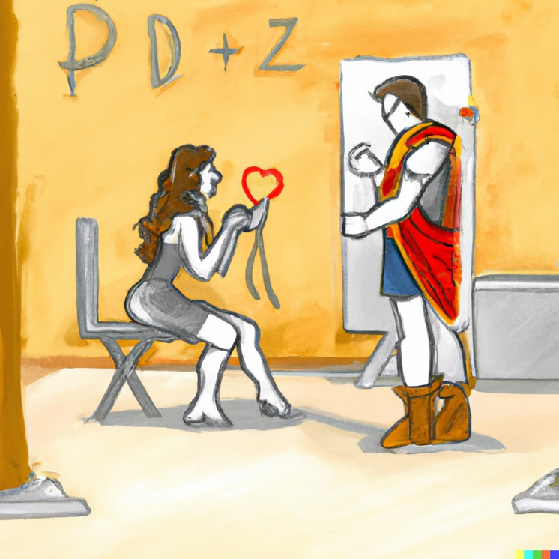
Individual causal effects
Consider Zeus and Hera, patients waiting for a heart transplant.
Let A=1, if an individual is actually treated; 0 if not
Let Y=1, if the individual actually died; 0 if survived
This is what actually happened. We can also consider whether each would have died if they had received the other treatment.

Slide 7
Counterfactuals: What would have happened if an individual had/had not received a treatment?
In contrast to A, the actual treatment, and Y, the actual outcome, consider:
Y^{a=1}, the hypothetical outcome if the individual had gotten hypothetical treatment a=1, and
Y^{a=0}, the hypothetical outcome if the individual had gotten hypothetical treatment a=0
These hypothetical events are also called counterfactual events, or counterfactuals or potential events.

Slide 8
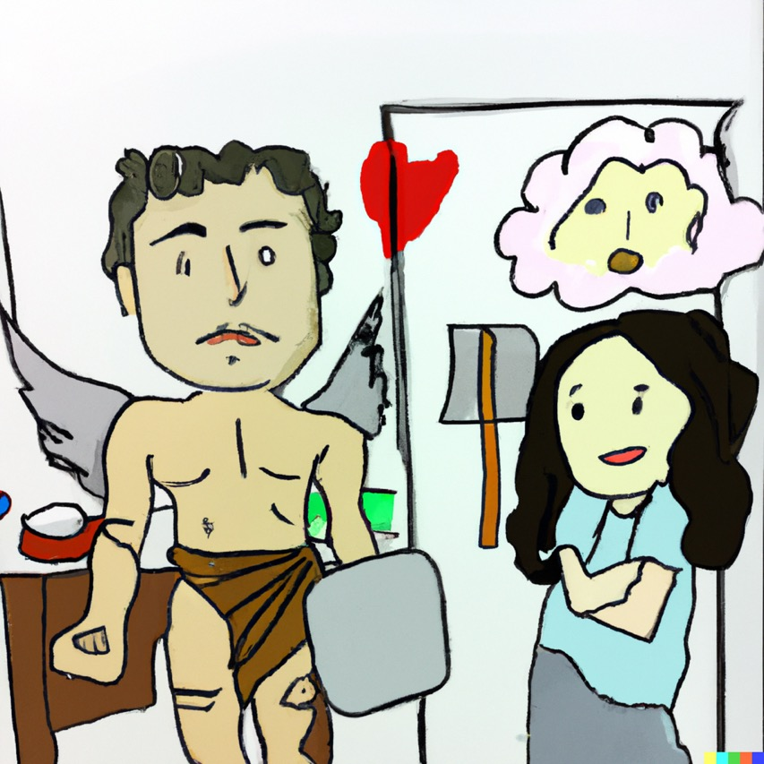
Back to Hera and Zeus: Counterfactuals vs. Actual Events
Both Zeus and Hera received a heart transplant:
A_{z} = 1 and A_{H} = 1
However, Zeus died and Hera lived:
Y_{z} = 1 and Y_{H} = 0
Where it gets interesting:
Say that we know, by divine methods, that HAD Zeus not received the transplant, he’d be alive, and HAD Hera not received the transplant she’d also be alive.
Our intuitive and legal definition of cause implies: transplant was causal in Zeus’ death, but not for Hera

Slide 9
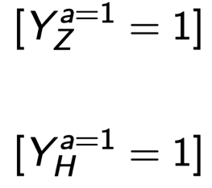

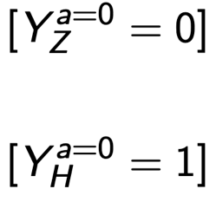
Back to Hera and Zeus: Counterfactuals vs. Actual Events
transplant was causal in Zeus’ death, but not for Hera
Both Zeus and Hera (actually) received a heart transplant:
A_{z} = 1 and A_{H} = 1
However, Zeus (actually) died and Hera (actually) lived:
Y_{z} = 1 and Y_{H} = 0
Now let’s add in their counterfactuals:
0
0
Treated
Untreated
Notes:
Made correction that since Hera lives in both cases, Y_H = 0 (since Y = 1 if died, and Y = 0 if lived)

Slide 10
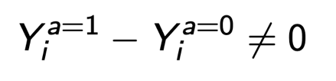
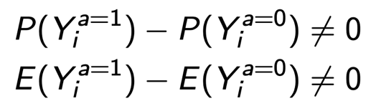
It’s causal for Zeus but not for Hera
A causal effect for the i^{th} individual refers to whether their outcomes would be different if they do/do not get the treatment:
An average (marginal) causal effect means that the probability of the hypothetical outcome is different depending on the hypothetical treatment:
…and if we knew all the counterfactual outcomes, we could estimate these probabilities using proportions, just as we would in the real world.
Notes:
Note that the formulation as an expected value works for categorical *or* continuous outcomes Y.
An average causal effect is a population average, or marginal causal effect.
Note that an average causal effect refers to a comparison of both counterfactuals, when treatment did vs. did not occur, not the percent or average of actual events.

Slide 11
Individual vs. average causal effect
Y^{a=0} Y^{a=1}
Rheia 0 1
Kronos 1 0
Demeter 0 0
Hades 0 0
Hestia 0 0
Poseidon 1 0
Hera 0 0
Zeus 0 1
Artemis 1 1
Apollo 1 0
Leto 0 1
Ares 1 1
Athena 1 1
Hephaes-
tus 0 1
Aphro-
dite 0 1
Cyclope 0 1
Perseph-
one 1 1
Hermes 1 0
Hebe 1 0
Dionysus 1 0
Is there an average causal effect in this population?
To answer this, we must know *both* sets of counterfactuals.
Let’s consider:
P(Y ^{a=1} = 1) - P(Y_{i} ^{a=0} = 1)
Hernan(2021), ch. 1

Slide 12
Individual vs. average causal effect
Y^{a=0} Y^{a=1}
Rheia 0 1
Kronos 1 0
Demeter 0 0
Hades 0 0
Hestia 0 0
Poseidon 1 0
Hera 0 0
Zeus 0 1
Artemis 1 1
Apollo 1 0
Leto 0 1
Ares 1 1
Athena 1 1
Hephaes-
tus 0 1
Aphro-
dite 0 1
Cyclope 0 1
Perseph-
one 1 1
Hermes 1 0
Hebe 1 0
Dionysus 1 0
Is there an average causal effect in this population?
To answer this, we must know *both* sets of counterfactuals.
P(Y^{a=1} = 1) - P(Y ^{a=0} = 1)
10/20 - 10/20 = 0
Comparison of the counterfactuals shows there is no average causal risk of death from a heart transplant in this population.
Hernan(2021), ch. 1

Slide 13

Thoughts on Zeus, Hera, and all of Mt Olympus?
What about this definition of an individual causal effect do you find natural?
What about this definition of individual causality troubles you?
What are your thoughts about average causal effects in the population?

Slide 14
Association is Causation when Identifiability Conditions are Met
This is kind of the astonishing central theory of our course ☺

Slide 15

When Does Association Imply Causation?
Classical statistics said association does not imply causation.
Causation had to be established by scientific logic, not statistics.
The theory of causal inference provides specific mathematical ‘identifiability conditions’ under which association implies causation.
The three identifiability assumptions

Slide 16


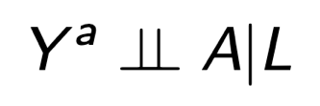
When Does Association Imply Causation?
The identifiability conditions required for an association to imply causation are:
(Causal) consistency
Positivity
(Causal) Conditional exchangeability

Slide 17
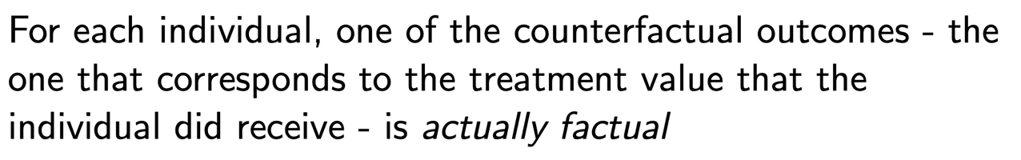
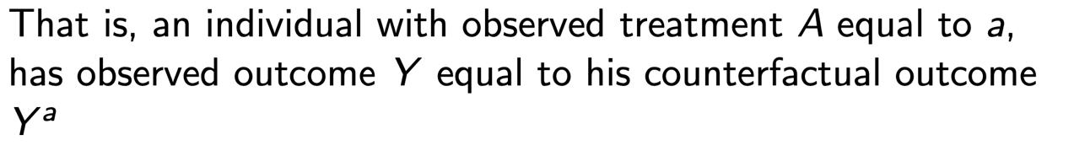
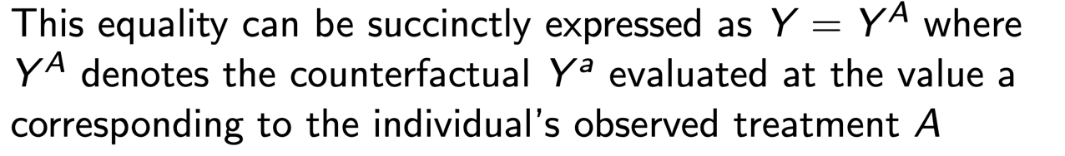
Consistency: The actual factual and why we can consider the problem a missing data problem

Slide 18

Consistency: The actual factual and why we can consider the problem a missing data problem
Recall: we never have “full data”

Slide 19
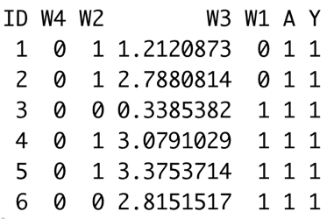

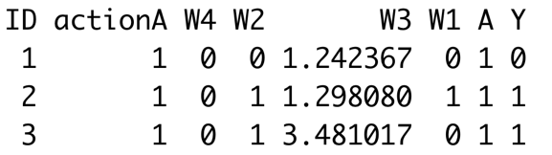
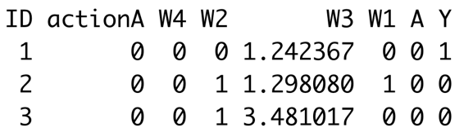
Idea of observed vs FULL data
Recall: we never have “full data”
Observed
A
A=1
Y(1)
Y
A=0
Y(0)
Full
A=1
Y(1)
A
Y
A=0
Y(0)

Slide 20
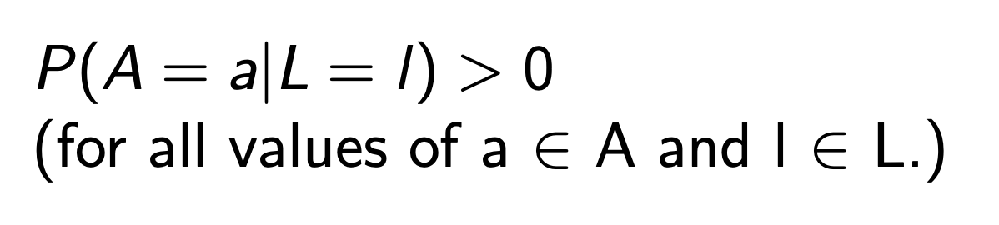
Positivity
“[t]he identifiability of causal effects requires sufficient variability in treatment or exposure assignment within strata of confounders.”
The positivity assumption states that each possible treatment level occurs with some positive probability within each stratum of L.
Positivity can be tested from the (observed) data.
(Positivity is only needed for the values of L present in the population of interest.)

Slide 21
Real-World Example: COVID ~ treatment A
8,304 patients:
Age 18+
Inpatient encounter
Diagnosis of COVID-19
Mean LoS – 3.6 days
65% treated with treatment A
Analytic dataset: 150+ variables
POSITIVITY ISSUES!
P(A=1|W=w) ~ 0 for some w
Ask: Does this question have support in this data?
Answer: Probably not as formulated
Maybe reconsider in light of treatment dynamics

Slide 22
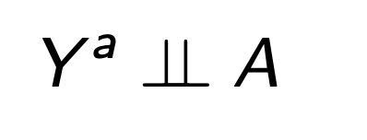
(Causal) Conditional exchangeability
Treated and untreated individuals are exchangeable when the assignment of treatment does not depend on the potential outcomes, i.e., when there is no unmeasured confounding that is driving both treatment and outcome.
In randomized experiments, the treated and the untreated are exchangeable because the treated, had they remained untreated, would have experienced the same average outcome as the untreated did, and vice versa.
Read: “Yª is independent of A”

Slide 23
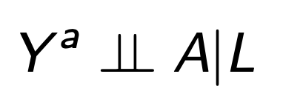
(Causal) Conditional exchangeability
In observational studies, when the investigators do not randomly assign treatment, the reasons for receiving treatment are likely to be associated with some outcome predictors (L).
If the conditional probability of receiving every value of treatment depends only on measured covariates L:
Read: “Yª is independent of A given L”

Slide 24
(Causal) Conditional exchangeability
It’s also called the assumption of ‘no unmeasured confounders,’ because if an uncontrolled factor C causes both counterfactual outcomes Yª and intervention A, this induces dependence between Yª and A.

Slide 25
SUTVA: stable unit treatment value assumption
no interference between units
SUTVA implies that an individual’s counterfactual outcomes are assumed independent of other individuals’ treatments.
Under the no-interference assumption, the potential outcomes of any individual are assumed to be unaffected by the treatment assignment of every other individual.
However, in many settings, this assumption obviously does not hold, e.g., vaccinations and infectious diseases.
Notes:
SUTVA implies that the potential outcomes for a given unit do not vary with the treatments assigned to any other unit, and that there are not different versions of treatment (Rubin 1978).

Slide 26
Does my non-randomized study (or randomized study under imperfect conditions) meet the identifiability conditions?
If consistency, positivity, and exchangeability hold, then association implies causation.
When there is confounding or selection bias, it is sufficient that consistency, positivity, and conditional exchangeability hold, i.e., no unmeasured confounders, and effects of selection are mitigated by adjustment.
Causal consistency must be assumed.
Positivity can be checked by diagnostics.
Causal conditional exchangeability can be checked using causal diagrams based on DAGs.

Slide 27
Does my non-randomized study (or randomized study under imperfect conditions) meet the identifiability conditions?
“We will see that these conditions are often heroic, which explains why causal inferences from observational studies are viewed with suspicion.
However, if the analogy between an observational study and a conditionally randomized experiment happens to be correct, then we can […] identify causal effects from observational studies.
We, therefore, refer to these conditions as identifiability conditions or assumptions.”
-What if, pg 26

Slide 28
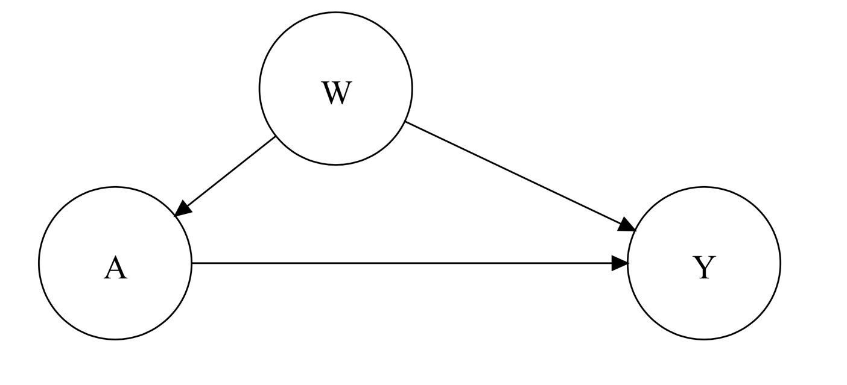
A gentle introduction to DAGs, examples, and frontiers

Slide 29
Directed Acyclic Graphs (DAGs)
Directed acyclic graphs (DAGs) are visual representations of causal assumptions
They encode our assumptions about the way variables relate to each other
DAGs can help untangle seemingly paradoxical findings and inform analyses
External factors
For a more formal treatment, I recommend:
Shrier, I., & Platt, R. W. (2008). Reducing bias through directed acyclic graphs. BMC Medical Research Methodology, 8, 70. https://doi.org/10.1186/1471-2288-8-70
Treatment
Outcome

Slide 30
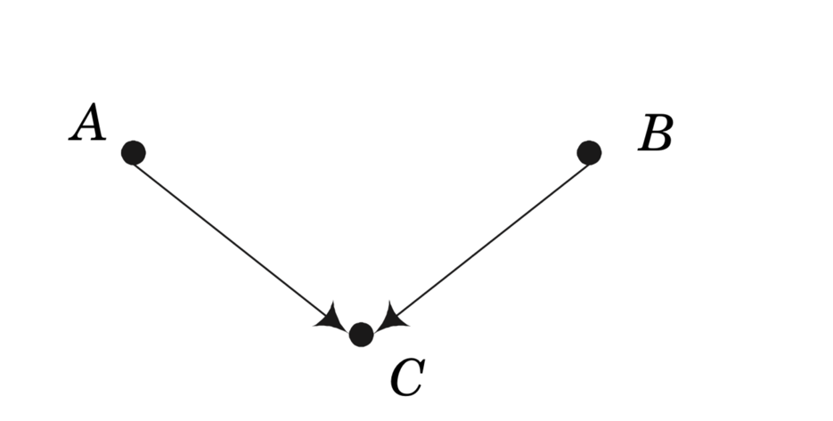
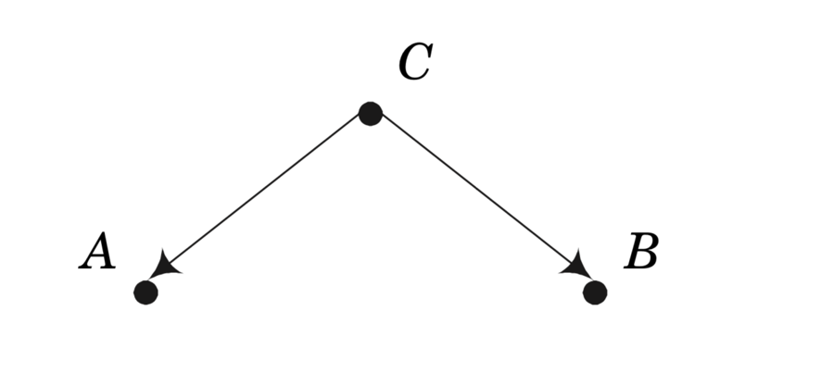
DAGs representing confounding
Common cause confounding
Collider
Smoking
Bad egg-salad
Influenza
Carry lighter
Lung cancer
Fever
Distorted association when not controlling for the confounder
Distorted association when controlling for the collider

Slide 31
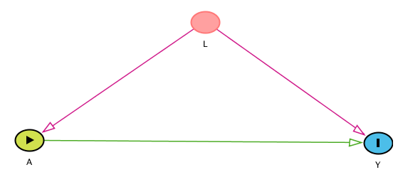
DAGs can guide confounding adjustment
Adjustment using regression techniques will sometimes reduce bias due to confounding or selection bias.
(Adjustment for confounding “closes backdoor paths.”)
Sometimes, adjustment will make bias worse.
(Adjusting for a collider “opens a backdoor path.”)
DAGs are very useful in determining which variables to include in adjustment sets.
Minimal sufficient adjustment sets for estimating the total effect of A on Y:
L
Notes:
Think of association as water flowing through pipes (edges) in the causal diagram. We want to close backdoor paths to the outcome Y so that only the forward, causal path allows association to flow from X to Y.

Slide 32
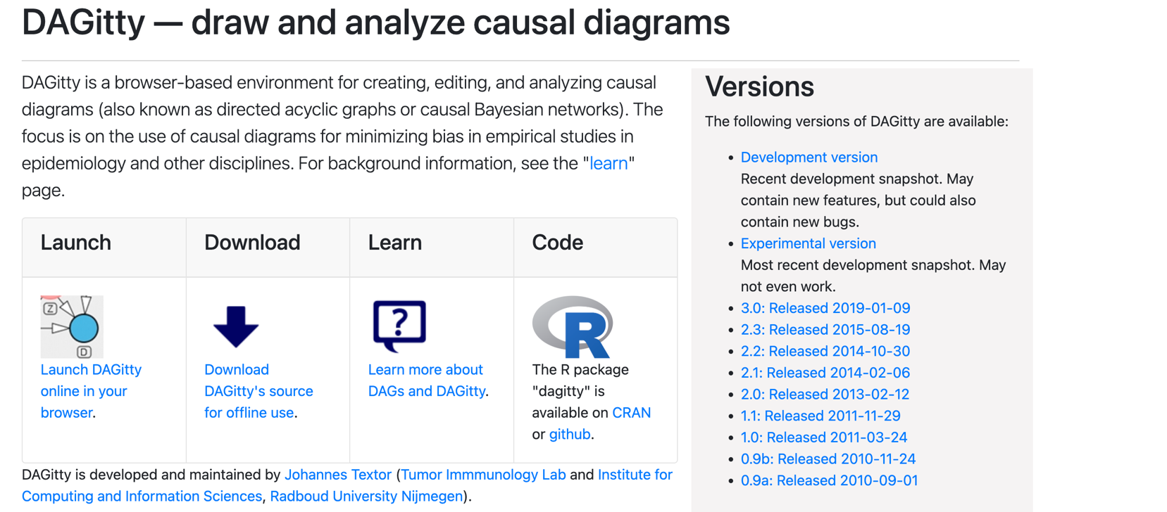
www.dagitty.net

Slide 33
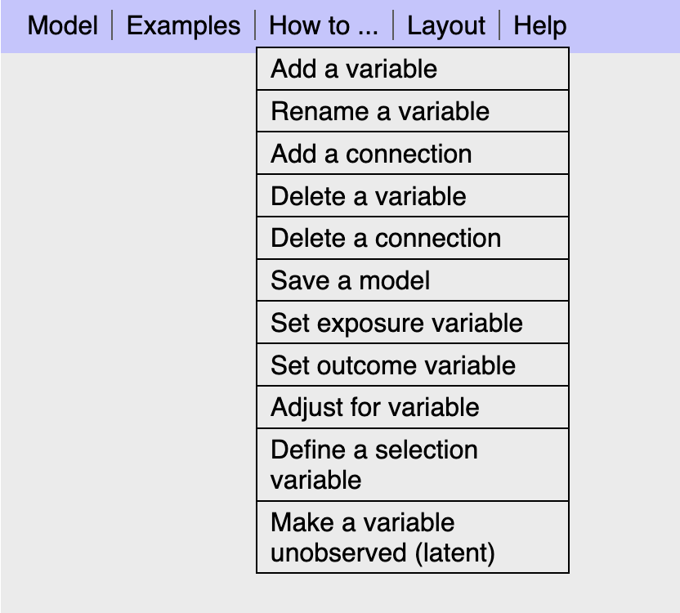
Explore the how-to

Slide 34
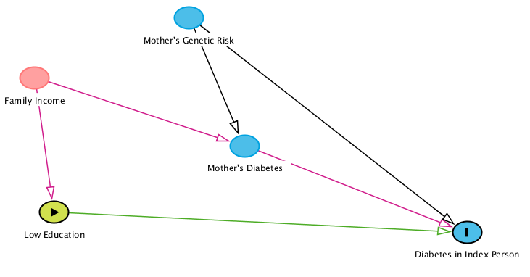
Let’s reproduce this diabetes example
Notes:
A green circle with a black outline means that low education is the exposure of interest. A blue circle with a black outline means that diabetes in the index person is the outcome of interest. Other variables will be blue or green if they fall on paths to the outcome or exposure. But if they fall on paths of confounding, affecting both the outcome and the exposure, they and the edges connecting them will be red!

Slide 35
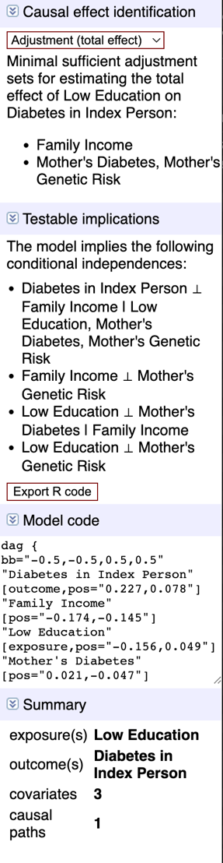
Dagitty Code
dag {
bb="-0.5,-0.5,0.5,0.5"
"Diabetes in Index Person" [outcome,pos="0.227,0.078"]
"Family Income" [pos="-0.174,-0.145"]
"Low Education" [exposure,pos="-0.156,0.049"]
"Mother's Diabetes" [pos="0.021,-0.047"]
"Mother's Genetic Risk" [pos="-0.031,-0.232"]
"Family Income" -> "Low Education"
"Family Income" -> "Mother's Diabetes"
"Low Education" -> "Diabetes in Index Person"
"Mother's Diabetes" -> "Diabetes in Index Person"
"Mother's Genetic Risk" -> "Diabetes in Index Person"
"Mother's Genetic Risk" -> "Mother's Diabetes"
}

Slide 36
Diabetes example: Use Dagitty to find sufficient adjustment sets
{Family income} or
{Family income, mother’s genetic risk} or
{mother’s genetic risk, mother’s diabetes}
…and minimally sufficient adjustment sets
{Family income}
Regression adjustment of a sufficient adjustment set of variables will mitigate the distortions in associations due to confounding or selection bias.
Notes:
This means that if your goal is to test the effect of the exposure “low education” on the outcome “diabetes in the index person”, you have choices of adjustment variables in a regression type analysis. But if you adjust for mother’s diabetes, *you must also* adjust for mother’s genetic risk.

Slide 37
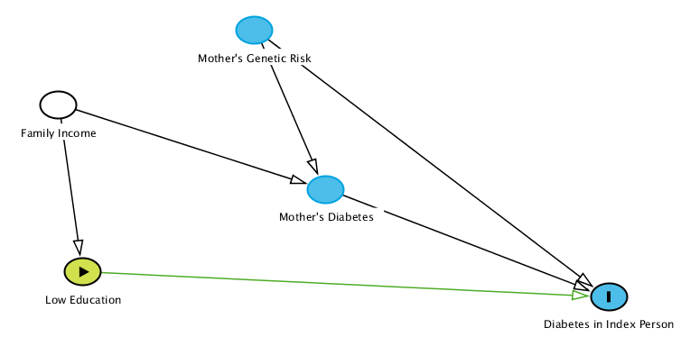
Watch the biasing pathways (disappear)
(hover over variable and type ‘a’)
Adjusting for:
Family Income

Slide 38
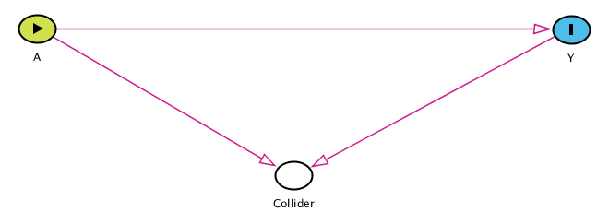
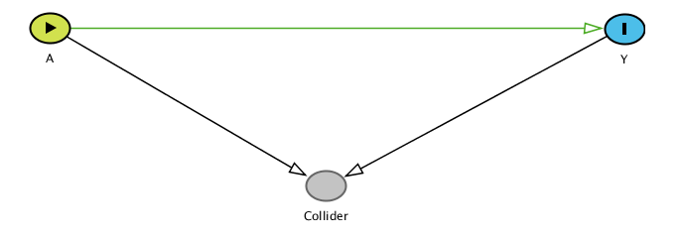
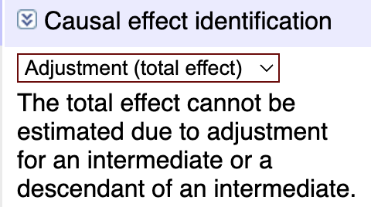
Watch the biasing pathways (COME BACK!)
Notice no biasing pathways … until

Slide 39

Recap

Slide 40
Counterfactuals and Cause
Example of Zeus and Hera
Individual vs average causal effects
Identifiability assumptions
DAGs and Dagitty
Next time – more on DAGs and SIMULATION

Slide 41
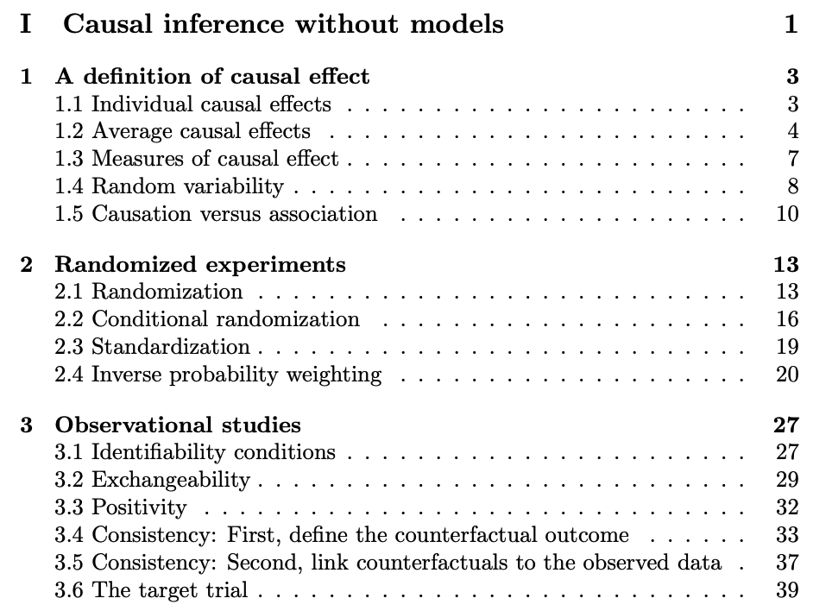
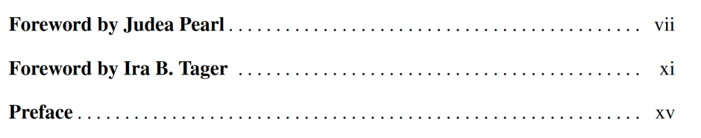
Readings
Be about here in reading by next time
From Hernán and Robins: Ch 1-3
From van der Laan TL book: Forwards and Preface

Slide 42
Reference and notes

Slide 43
Causal Diagrams have rigorous theoretical support
Graphical conditions for adjustment, which avoid inducing noncausal association as an artifact, have been rigorously derived by Pearl and others and explicated by Pearl(2009), Greenland, Pearl, and Robins (1999) and others.
Robins showed that Pearl’s theory is equivalent to his g-computation theory. (see, e.g., Greenland, 1999.)
Shrier and Platt (2008) provided a 6-step algorithm to check whether an analysis of X, Y, and proposed adjustment variables {Z} adjusts appropriately without inducing noncausal association.
Efficient software now exists to identify all ‘minimal sufficient adjustment sets,’ e.g., DAGitty (Textor,2011a), TETRAD (Glymour, 2004)
Notes:
The most definitive conditions to date are the generalized adjustment criterion of Perkovic, 2015.

Slide 44
References 1
Breitling LP: dagR: A Suite of R Functions for Directed Acyclic Graphs. Epidemiology: 21(4):586-587, July 2010; http://journals.lww.com/epidem/Fulltext/2010/07000/dagR__A_Suite_of_R_Functions_for_Directed_Acyclic.26.aspx
Brooks JM. Supplement 1. Improving Characterization of Study Populations: the identification problem In: Velentgas P, Dreyer NA, Nourjah P, et al., eds. Developing a Protocol for Observational Comparative Effectiveness Research: A User’s Guide. AHRQ Publication No. 12(13)-EHC099. Rockville, MD: Agency for Healthcare Research and Quality; January 2013: Supplement 1, pp. 161-178. https://www.ncbi.nlm.nih.gov/books/NBK126190/
Glass TA, Goodman SN, Hernan MA, Samet JM. Causal Inference in Public Health. Annu. Rev. Public Health 2013; 34:61–75.
Glymour M: Using Causal Diagrams to Understand Common Problems in Social Epidemiology, in JM Oakes and JS Kaufman, eds. Methods in Social Epidemiology, New York: Jossey-Bass, 2006, ch. 16.
Glymour C, Scheines R, Spirtes P, Ramsey J. TETRAD, 2004. http://www.phil.cmu.edu/projects/tetrad/
Greenland S, Pearl J, Robins J: Causal Diagrams for Epidemiologic Research. Epidemiology 10:37-48, 1999.

Slide 45
References 2
Hernan MA, Robins J. Causal Inference: What If. To be published at Chapman & Hall/CRC. http://www.hsph.harvard.edu/miguel-hernan/causal-inference-book/ accessed 1 25 2021. Glass TA, Goodman SN, Hernan MA, Samet JM. Causal Inference in Public Health. Annu. Rev. Public Health 2013; 34:61–75.
Hernán MA. Does water kill? A call for less casual causal inferences. Ann Epidemiol. 2016;26(10):674–680.
Hernán MA, Taubman SL. Does obesity shorten life? The importance of well-defined interventions to answer causal questions. International Journal of Obesity September 2008; 32 Suppl 3(suppl 3):S8-14DOI: 10.1038/ijo.2008.82
Imbens GW, Rubin DB. Causal Inference for Statistics, Social, and Biomedical Sciences: An Introduction. New York: Cambridge University Press, 2015.
Pearl J: Causality: models, reasoning, and inference, 2nd ed. Cambridge University Press, 2009.

Slide 46
References 3
Robins JM, Hernan MA. Estimation of the causal effects of time-varying exposures. In: Advances in Longitudinal Data Analysis. Fitzmaurice G, Davidian M, Verbeke G, Molenberghs G, eds. New York: Chapman and Hall/CRC Press, 2009, ch. 23.
Rosenbaum, PR: Observation and Experiment: An Introduction to Causal Inference. Cambridge: Harvard University Press, 2017 (hardback).
Sauer B, Brookhart MA, Roy JA, et al. Covariate selection. In: Velentgas P, Dreyer NA, Nourjah P, et al., eds. Developing a Protocol for Observational Comparative Effectiveness Research: A User’s Guide. AHRQ Publication No. 12(13)-EHC099. Rockville, MD: Agency for Healthcare Research and Quality; January 2013: Chapter 7, pp. 93-108. https://www.ncbi.nlm.nih.gov/books/NBK126190/
Sauer B, VanderWeele TJ. Use of Directed Acyclic Graphs. In: Velentgas P, Dreyer NA, Nourjah P, et al., eds. Developing a Protocol for Observational Comparative Effectiveness Research: A User’s Guide. AHRQ Publication No. 12(13)-EHC099. Rockville, MD: Agency for Healthcare Research and Quality; January 2013: Supplement 2, pp. 177-84. https://www.ncbi.nlm.nih.gov/books/NBK126190/

Slide 47
References 4
Shrier I, Platt RW:Reducing bias through directed acyclic graphs. BMC Medical Research Methodology 2008, 8:70,2008. http://www.biomedcentral.com/1471-2288/8/70
Textor J (a): DAGitty User Manual, March 24, 2011. http://dagitty.net/manual.pdf
Textor J, (b) Hardt J, Knüppel S. (b):DAGitty: A Graphical Tool for Analyzing Causal Diagrams. Epidemiology, 5(22):745, 2011. DAGitty v 1.0, www.dagitty.net
Textor J, Liśkiewicz M. (c) :Adjustment Criteria in Causal Diagrams: An Algorithmic Perspective. In Proceedings of the 27th Conference on Uncertainty in Artificial Intelligence (UAI 2011), Association for Uncertainty in Artificial Intelligence, 2011.
Van der Laan M, Rose S: Targeted Learning. New York: Springer, 2011.
Vittinghoff E, Glidden DV, Shiboski SC, McCulloch CE: Regression Methods in Biostatistics Book: Linear, Logistic, Survival, and Repeated Measures Models, 2nd ed. New York: Springer-Verlag, 2012 ch 9-10.

